Slide 1

Welcome to:
General Meeting
6 PM Tuesday, August 28, 2018
Broun Hall, Room 125

Slide 2




Agenda

Slide 3
About SPARC

Slide 4
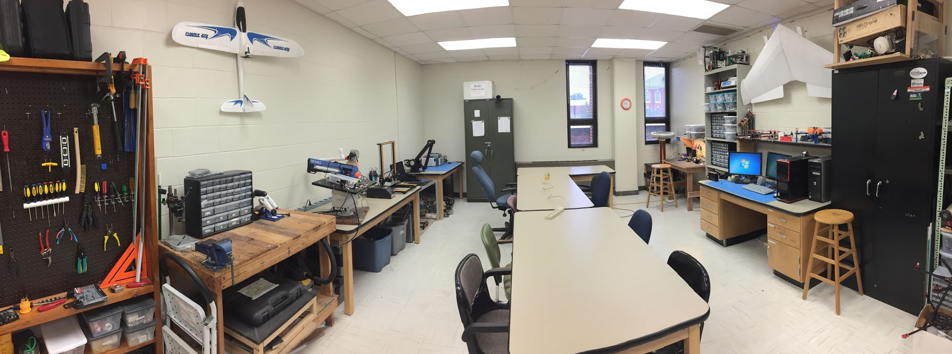
About SPARC
Creates and fosters an environment of creativity and innovation through collaborative projects.
A place to test out ideas, integrate concepts learned in class, and learn skills that will be instrumental when working in the workforce.
No prior experience is required, only a willingness to learn.
Lab:
- Broun 367
General Meetings:
- Tuesdays @ 6 in Broun 125
Project Meetings:
- Various Times during week

Slide 5
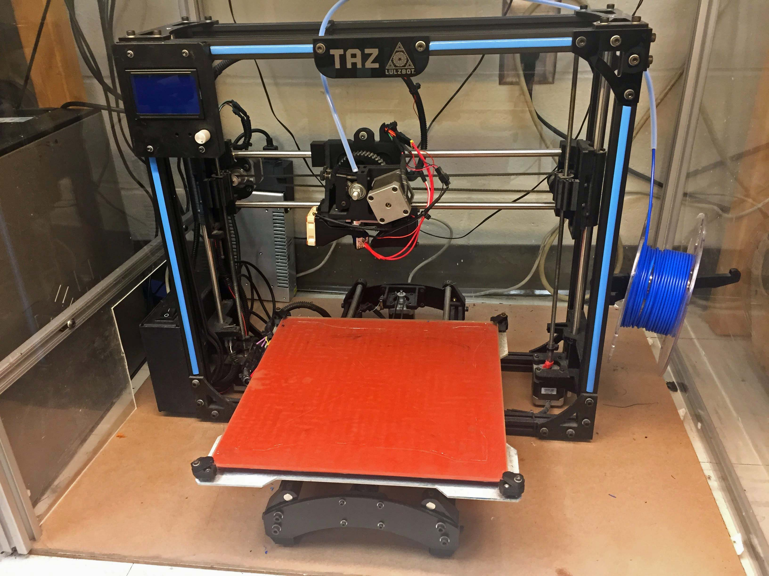
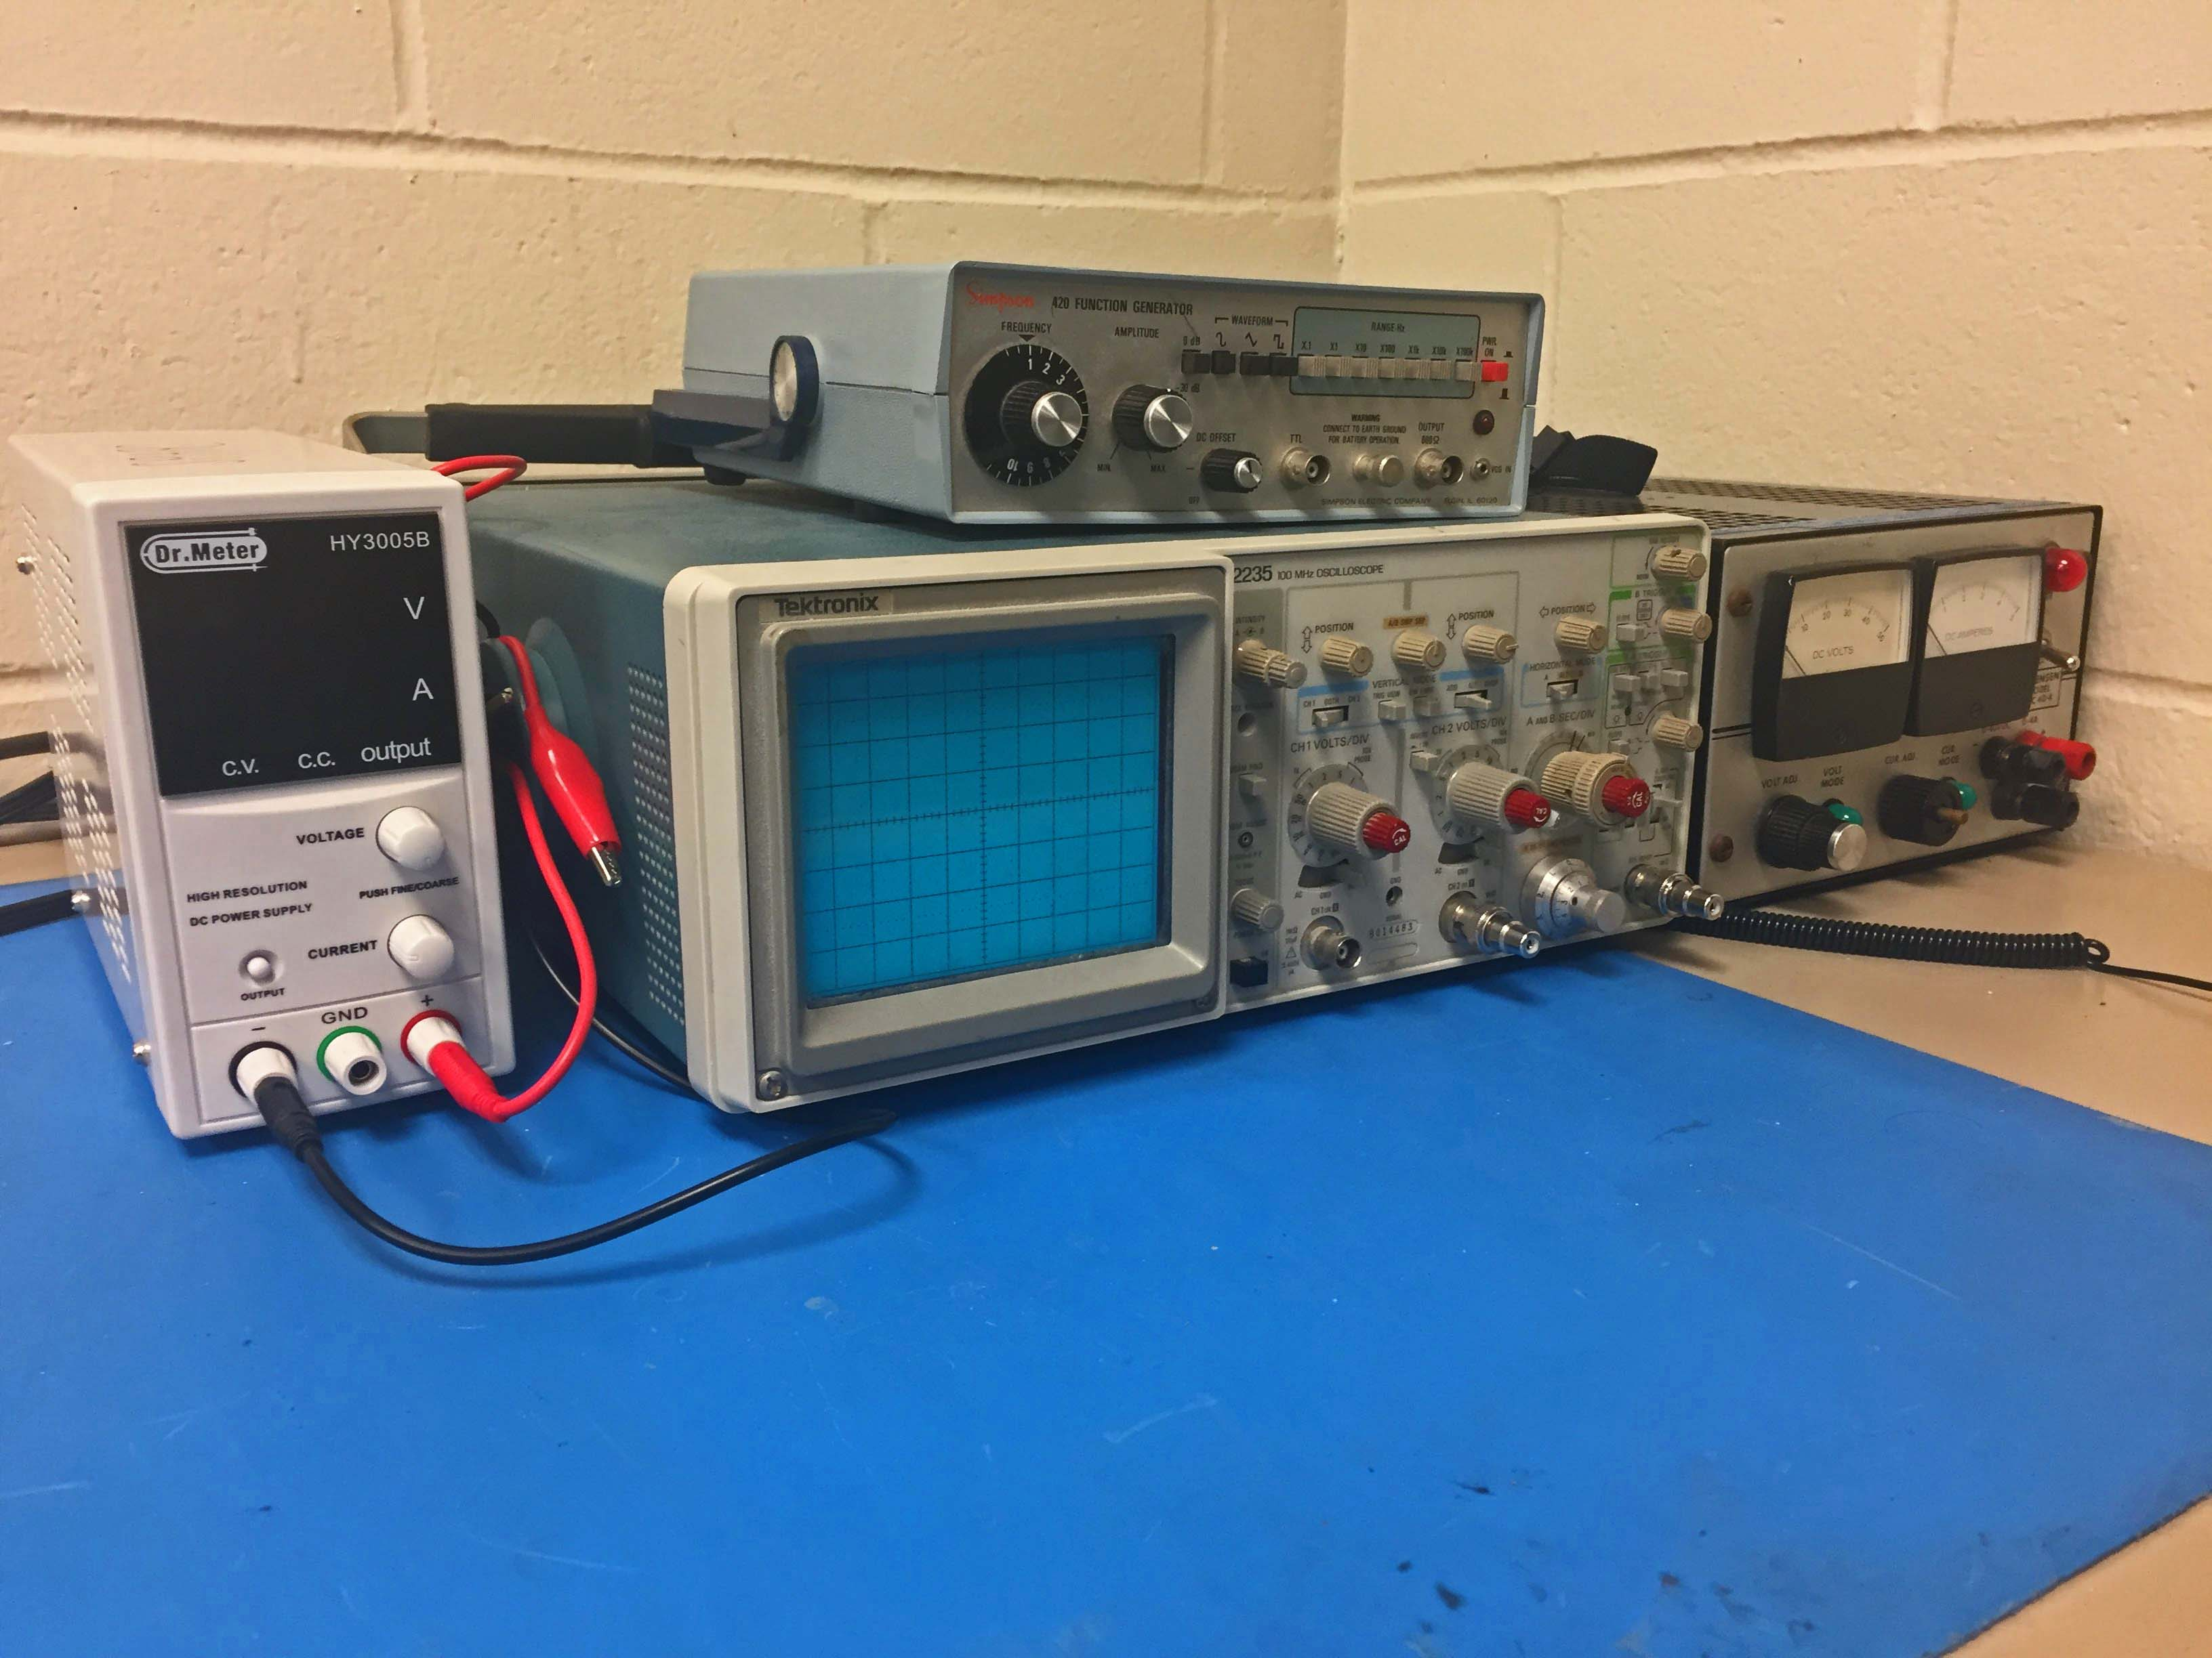
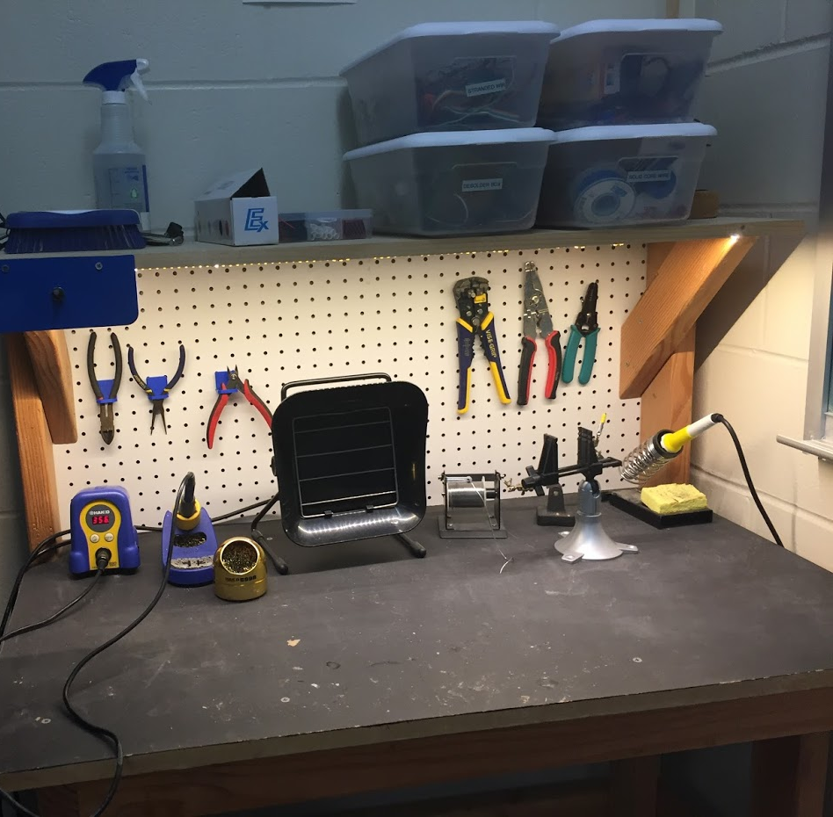
Our Lab
Broun Hall
Room 367

Slide 6
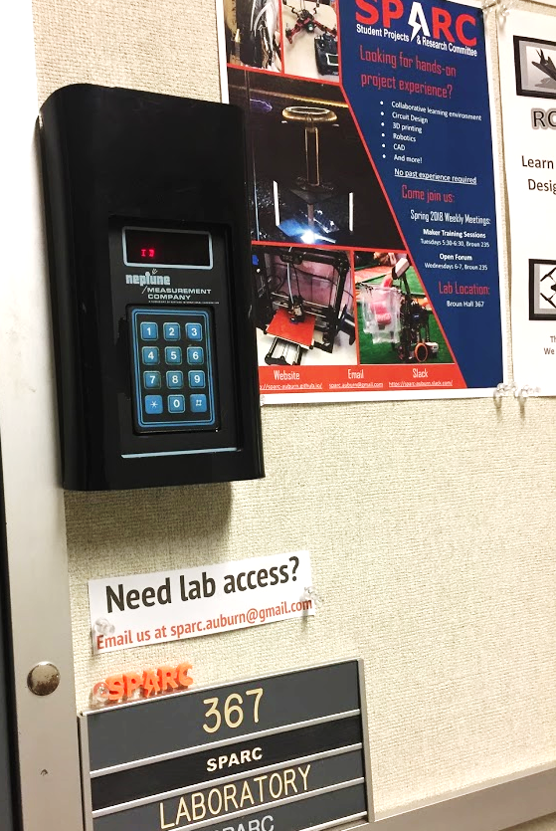
How to become a Member
Log 5 constructive hours in the lab
Write the times on the sheet on the clipboard next to the door.
Contact us at sparc.auburn@gmail.com
We will respond with the instructions to get an access code.

Slide 7




More Information about SPARC
Website
http://sparc.eng.auburn.edu/
Github
https://github.com/SPARC-Auburn
Slack
https://sparc-auburn.slack.com/
Email
sparc.auburn@gmail.com

Slide 8
Questions?
Notes:
6:10

Slide 9
Outreach and Recruitment

Slide 10
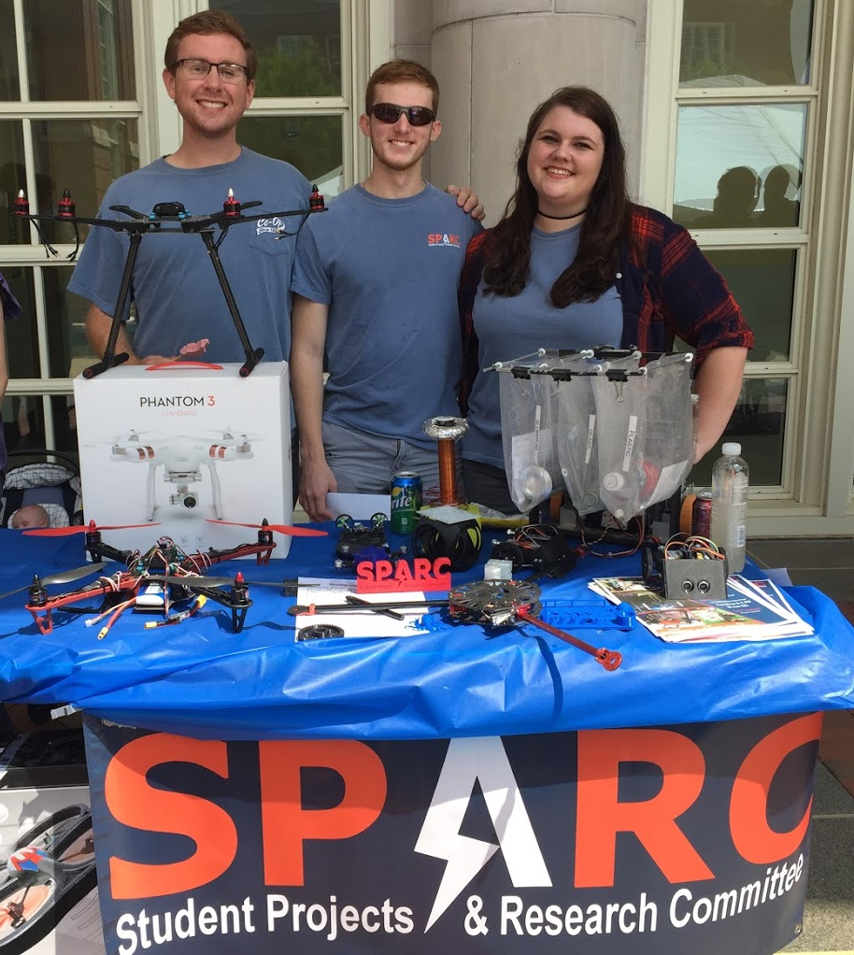
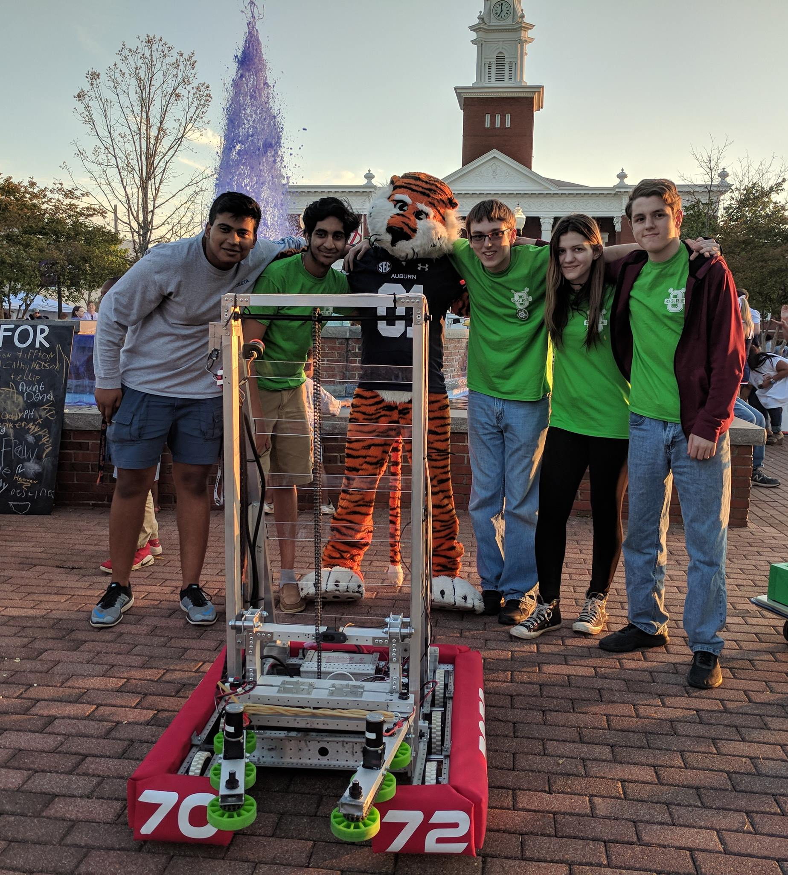
Upcoming Events
GRAND Engineering Showcase
Tuesday, September 11th for 4th-8th graders
AU Student Center Ballroom 5-7pm
Volunteers needed 1-8PM
Register: aub.ie/grandvolunteer
Volunteer Meetings (Thurs. Sept. 6th)
8:30am (breakfast)
12:30pm (lunch)
Opelika HS Robotics Team
Help mentor a local robotics team
Times: TWR: 3:30-6:30pm
Contact: Matthew Zacune <maz0006@auburn.edu>
Engineering BBQ 2018
FRC Team 7072 Bot
Notes:
Fall 2016
Loachapoka Robotics Mentoring- Mondays, Tuesdays, and Thursdays 3:00PM to 4:30PM
ECE Minority Presentation- November 14th
AJHS E-Day- November 17th
South’s Best- December 3-4th
SCORE Claw Machine- December 3-4th
Spring 2016
E-Day- Late February or early March
SPACE Day- Possible Event Next Semester
IEEE Sumo Robotics Competition (with local middle and high schools)- Spring 2017

Slide 11
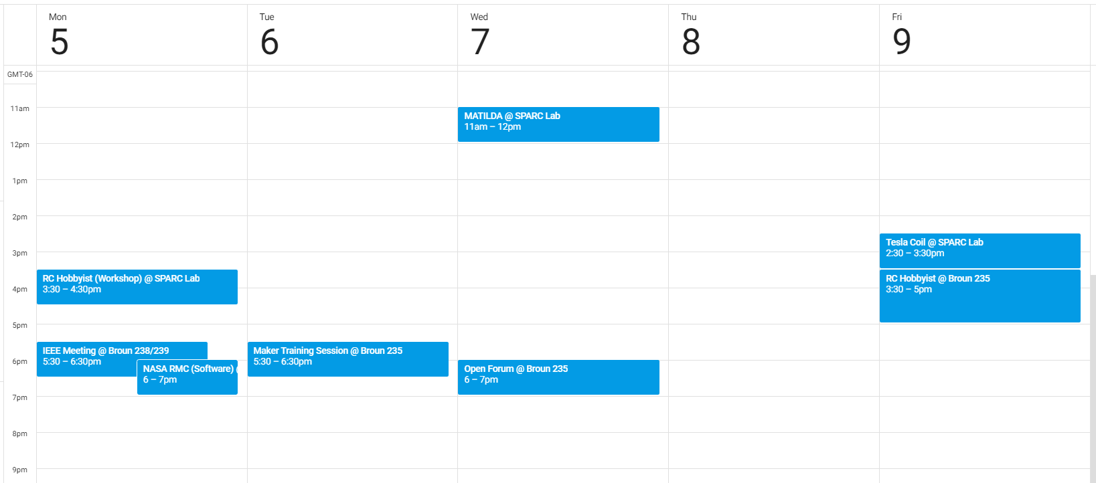
Meetings this Week

Slide 12
Project Open Forum

Slide 13
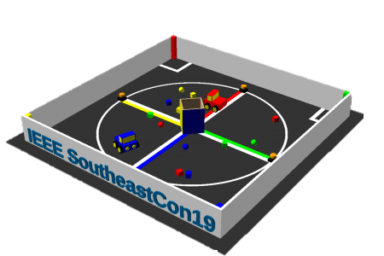
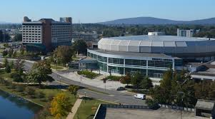
Major Project #1: IEEE Southeast con
Project lead: Matthew Castleberry
Electrical lead: Josh Jablonowski
Mechanical lead: Alex Jones
Slack Channel: #projectieee
Competition Details:
Build a “space debris” collecting robot
Goal is to collect wood blocks and ball pit balls and deposit them on the side of a small flat ~100” square arena autonomously.
Max dimensions: 9” x 9” x 11”
When and Where:
Thursday, April 11th, 2019 through Sunday, April 14th, 2019.
IEEE Southeastcon conference in Huntsville, AL
Meeting Times
Electrical/Software Meeting: TBD
Mechanical Meeting: TBD

Slide 14
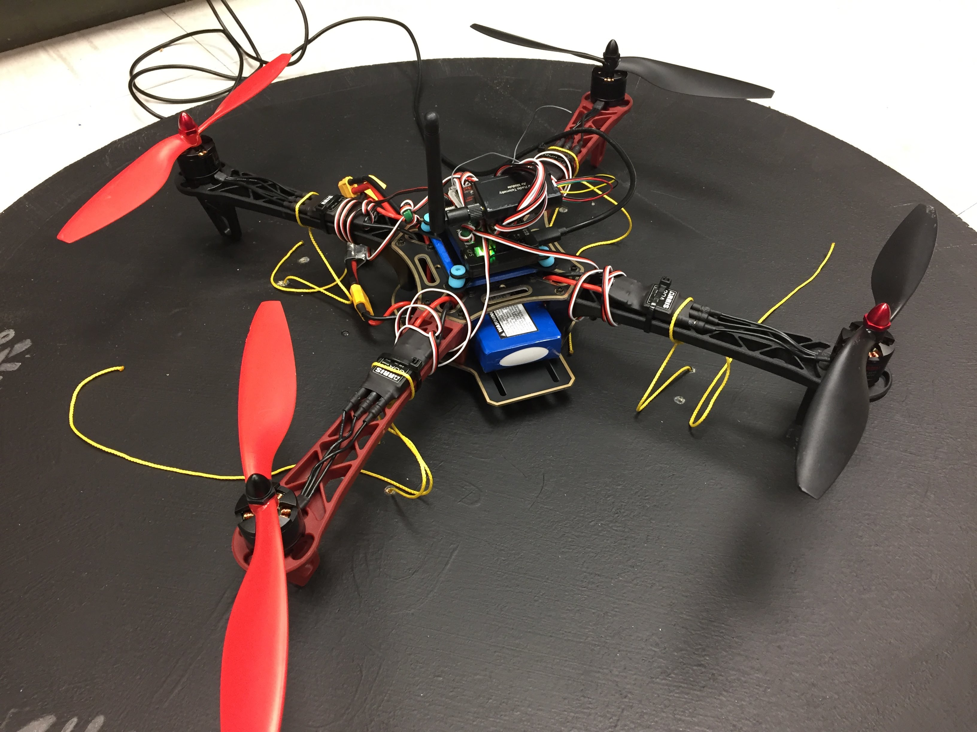
Major Project #2: Mail Bird
Project Lead: Ryan Moran
Slack Channel: #projectmailbird
Will be used to experiment with payload pickup, identification, and delivery
Partnership with RC Hobbyist Club
Semester Focus
Configure frame for waypoint navigation, etc.
Develop package release mechanism
Meeting Times
Wednesdays 11am – 1pm

Slide 15
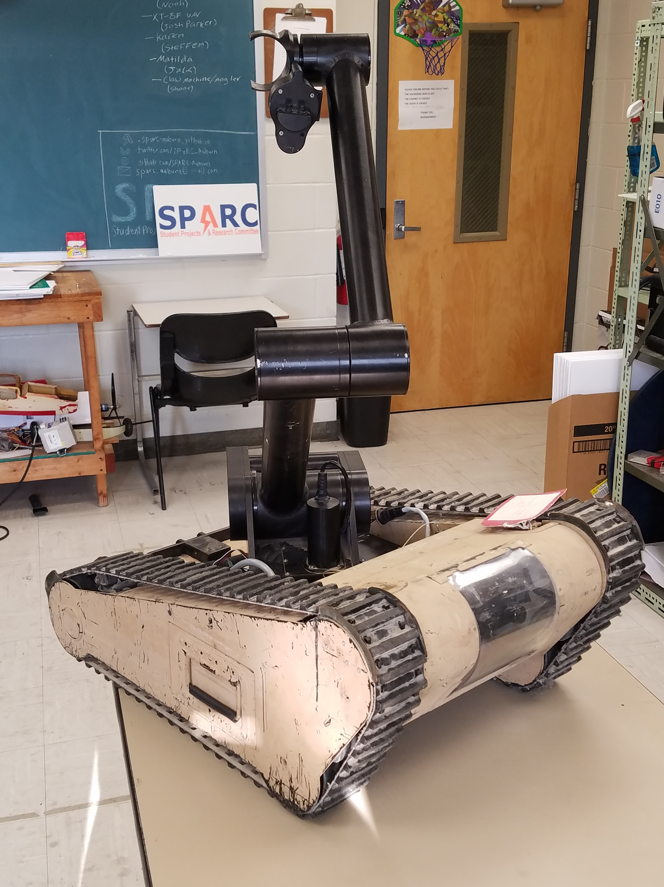
Major Project #3: MATILDA
Project lead: TBD
Slack Channel: #projectmatilda
MATILDA stands for Mesa Associates' Tactical Integrated Light-Force Deployment Assembly
A bomb disposal robot from Dr. Roppel’s research lab.
Is in disrepair both electrically and mechanically.
Arm is functional and controllable via Arduino.
Semester Focus
Reestablishing mobility.

Slide 16
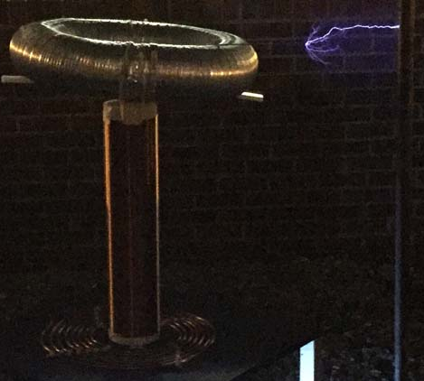
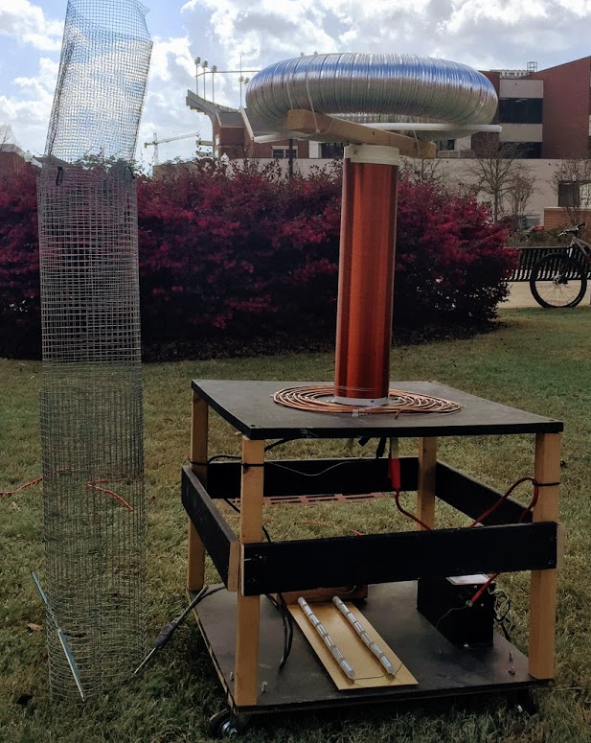
Side Project #1: Musical Tesla Coil
Project lead: TBD
Slack Channel: #projectteslacoil
Demonstrated Tesla Coil at Spring 2016/18 E-Days
Currently uses spark gap style circuitry
Generated estimated 400,000 volts of electricity.
Semester Focus:
Convert it into a musical Tesla Coil.
Develop circuit and PCB design for new components

Slide 17
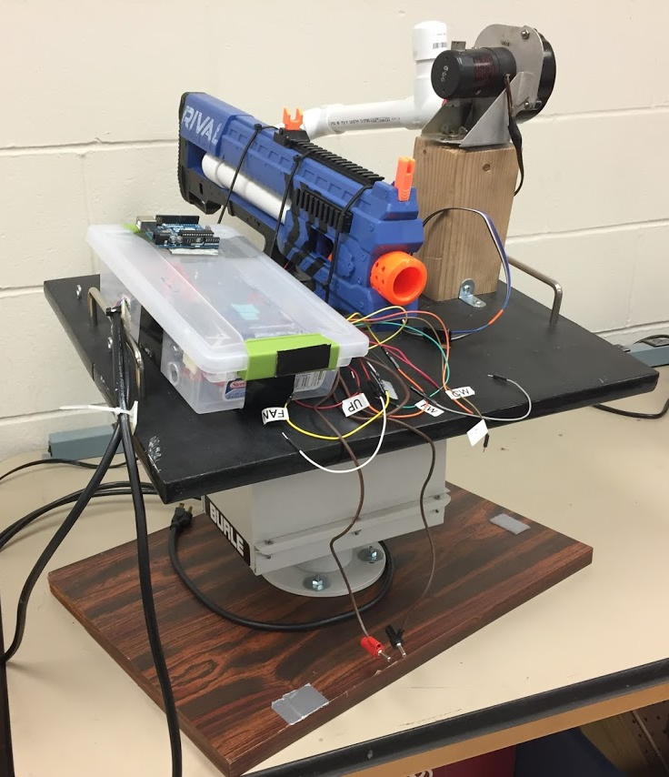
Side Project #2: Automate Nerf Turret
Project lead: TBD
Slack Channel: TBD
Old project donated by EE department
It was demonstrated last spring at E-Day and PEAK.
Needs a new purpose to improve demonstrations

Slide 18
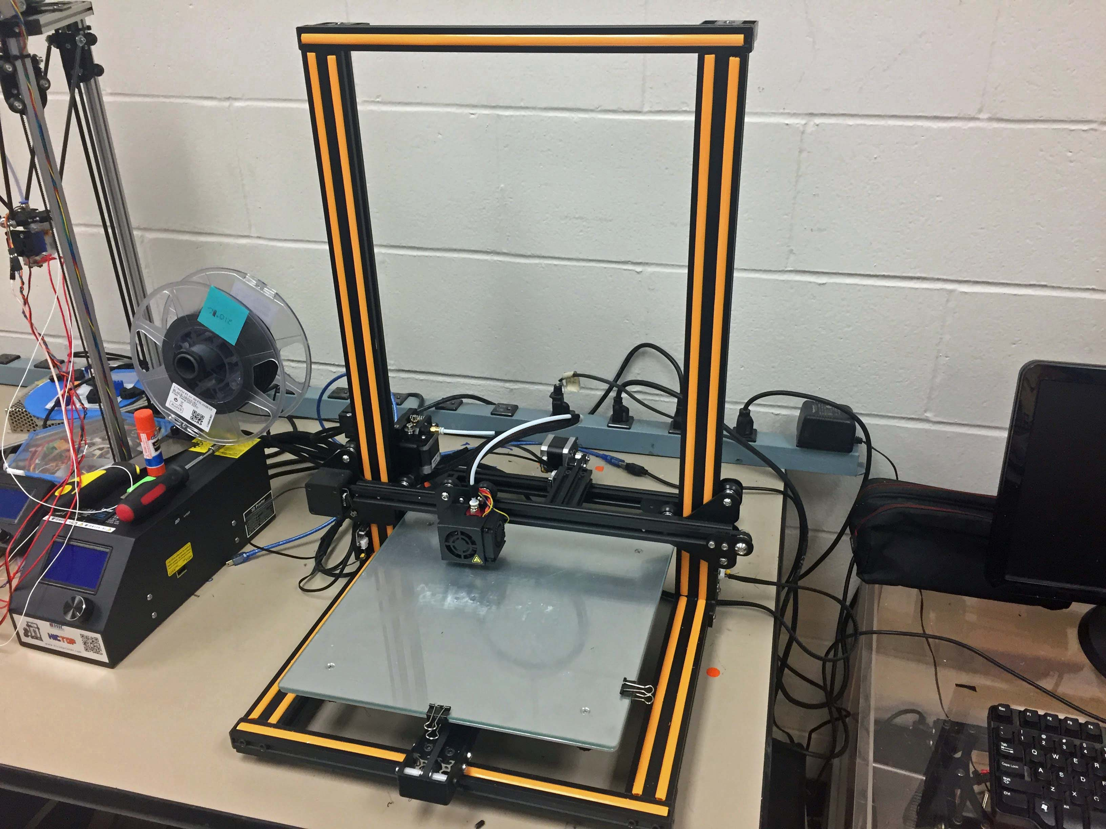
Side Project #3: 3D Print Enclosure
Project lead: Alex J. and Josh J.
Slack Channel: #3dprinting
Design double decker 3D printer enclosure to hold our Creality CR10 and Lulzbot Taz 3.
Will have wheels and have hinged doors
Will potentially use Octoprint on Raspberry Pi(s) to control printers.

Slide 19
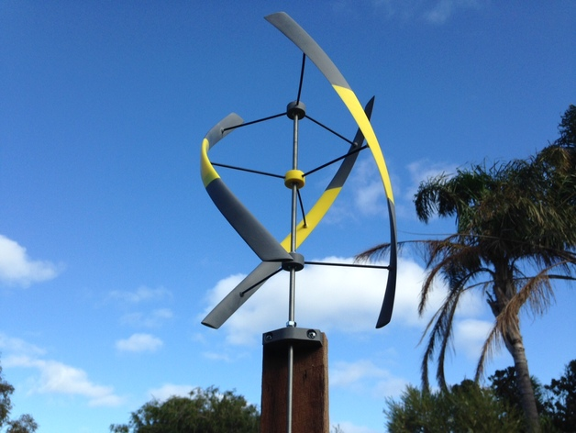
Side Project #4: Vertical Axis Wind Turbine
Project lead: TBD
Slack Channel: TBD
Will create a 3D printed vertical axis wind turbine to generate a small amount of electricity.
Potentially will be used as a cell phone charger.
https://www.thingiverse.com/thing:948401

Slide 20
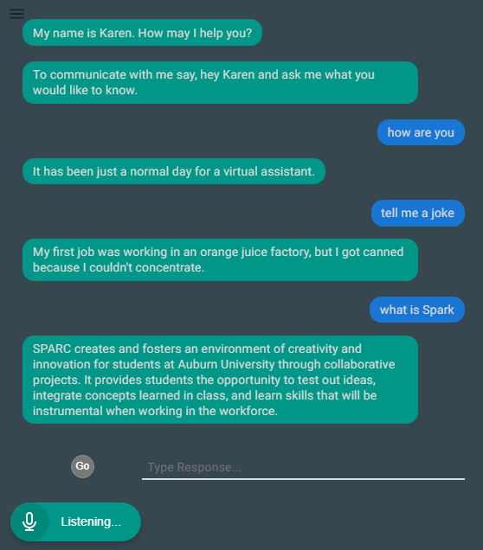
Side Project #5: Lab Assistant
Kinematic
Autonomous
Robot
Enriches
Newcomers
Lab
Information
Support
Tool
Project lead: TBD
Slack Channel: #projectlabassistant
Goal: create an automated lab assistant.
Is voice controlled.
One day will consist of both a stationary and mobile system.
Can be embedded on the new group chat system Slack.
Programmed in Node.JS (Framework of JavaScript)
Semester Focus
Add functionality
Add database for keeping track of members and equipment
Slack Channel
#projectlabassistant
Notes:
6:30

Slide 21
Project Ideas?
email us at sparc.auburn@gmail.com
or DM Matthew Castleberry @mcberry23 via Slack

Slide 22
Maker Training Session:
Raspberry Pi and Linux

Slide 23
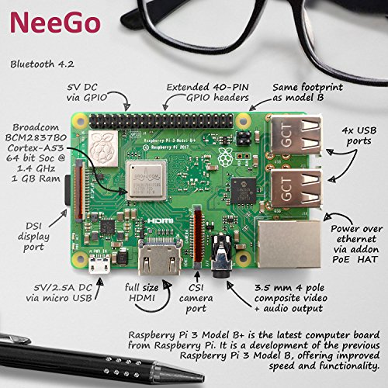
What is a Raspberry Pi?
A relatively inexpensive single board computer.
Only $5 for Zero or $35 for more powerful one
Capable of running operating systems such as Raspbian Linux, Ubuntu Linux, Windows 10 IOT, etc.
Originally released in February 2012.
Has USB ports, video outputs, and an audio output.
Is capable of connecting to the internet through WiFi or Ethernet.
Has General Purpose Input and Output Pins (GPIO) to control electronic circuits.

Slide 24
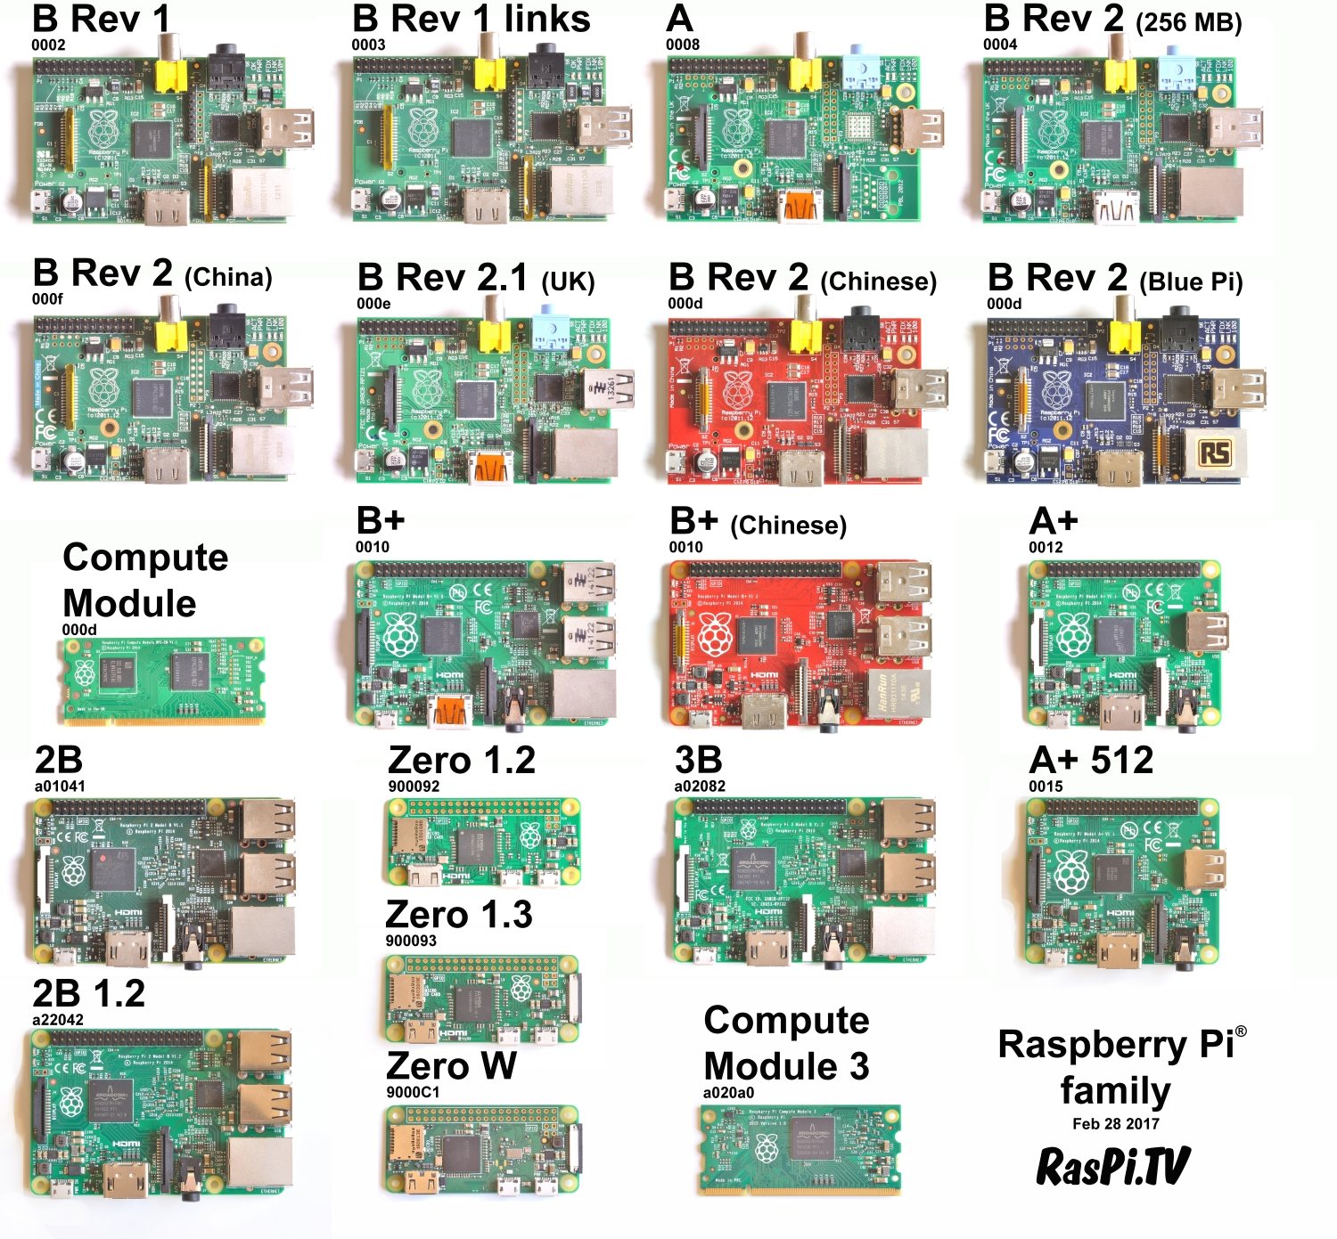
Different Versions of the Pi

Slide 25

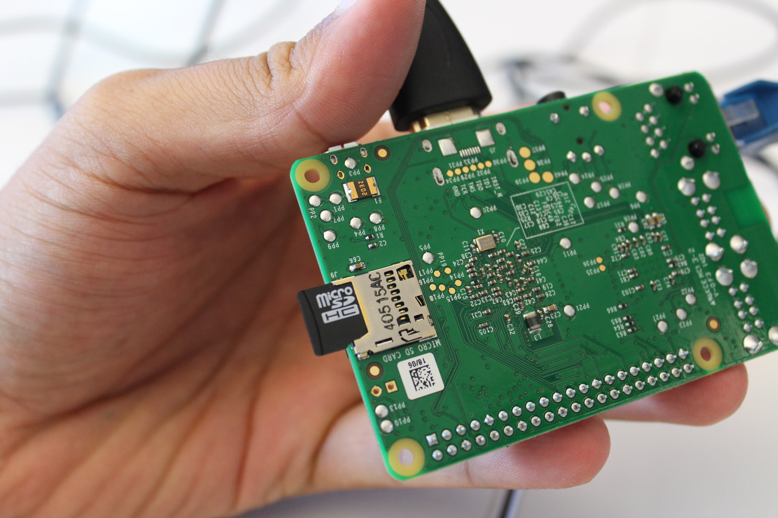
Setting up the Pi SD Card
The Pi main storage is on an SD card 4GB or greater.
Raspbian Linux is most highly supported operating system.
Download Raspbian or NOOBS from Raspberry Pi website.
https://www.raspberrypi.org/downloads/raspbian/
Follow the installation guide.
Will require you to download an SD image writer.
If display does not work a setting may need adjusted in .config file.
PC World

Slide 26
Additional Notes
Boot up by applying power using Micro USB.
Make change to .config file if no display.
Username is “pi” by default
Password is “raspberry” by default.
Open up terminal.
Type in commands.

Slide 27

What is Linux?
Common Linux Commands (dummies.com)
cat [filename] | Display file’s contents to the standard output device (usually your monitor).
cd /directorypath | Change to directory.
chmod [options] mode filename | Change a file’s permissions.
cp [options] source destination | Copy files and directories.
df [options] | Display used and available disk space.
du [options] | Show how much space each file takes up.
file [options] filename | Determine what type of data is within a file.
find [pathname] [expression] | Search for files matching a provided pattern.
grep [options] pattern [filesname] | Search files or output for a particular pattern.
ln [options] source [destination] | Create a shortcut.
locate filename | Search a copy of your filesystem for the specified filename.
ls [options] | List directory contents.
mkdir [options] directory | Create a new directory.
mv [options] source destination | Rename or move file(s) or directories.
ps [options] | Display a snapshot of the currently running processes.
pwd | Display the pathname for the current directory.
rm [options] directory | Remove (delete) file(s) and/or directories.
rmdir [options] directory | Delete empty directories.
ssh [options] user@machine | Remotely log in to another Linux machine, over the network.
su [options] [user [arguments]] | Switch to another user account.
tar [options] filename | Store and extract files from a tarfile (.tar) or tarball (.tar.gz or .tgz).
Linux is an open source operating system.
It is used in many products and servers.
Allows full customization.
Great for software development.
Hundreds of free distros.
Most have a Graphics User Interface (GUI) but can be setup without one.
Use the terminal for full customization.

Slide 28
Network and Python Commands
Network:
Download files: wget https://www.example.com/
Check connection: ping -c 4 google.com
Ultimate network utility: ifconfig
Python:
For installation if not installed: sudo apt-get install python3
To create new file: nano filename.py
To run file: sudo python filename.py

Slide 29
Connecting Via SSH
Secure Shell (SSH) is a cryptographic network protocol for operating network services securely over an unsecured network. (Wikipedia)
Steps to Use SSH
Get ip address of Pi via “ifconfig”
Windows Client
Open IP via Putty (https://www.putty.org/)
Mac/Linux Client
Use “ssh user@machine” command in terminal
Login using credentials as if on device

Slide 30
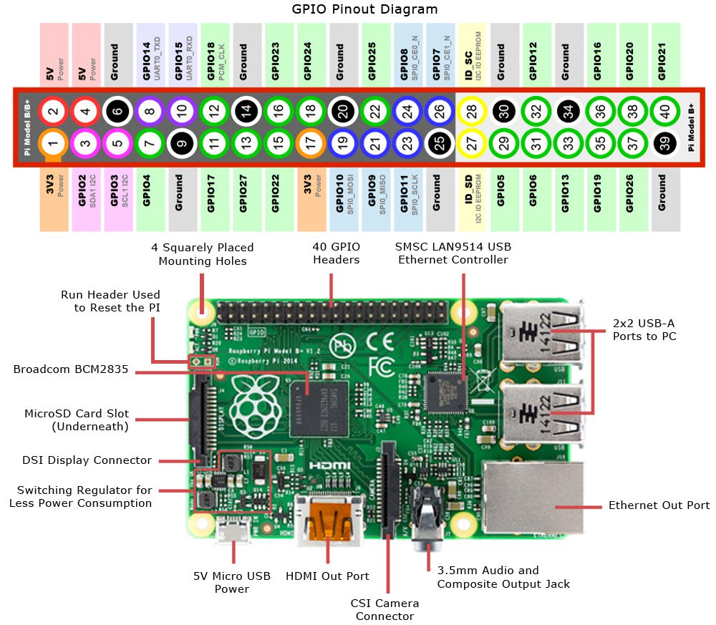
GPIO on Raspberry Pi

Slide 31
Using GPIO with Python
import RPi.GPIO as GPIO
import time
GPIO.setmode(GPIO.BCM) #sets pin numbers
GPIO.setup(8, GPIO.OUT) #sets pin 8/GPIO 14 to output
for i in range(0,50): #start loop
GPIO.output(8,GPIO.HIGH) #turn LED on
time.sleep(1) #wait one second
GPIO.output(8,GPIO.LOW) #turn LED off
time.sleep(1) #wait one second
GPIO.cleanup() #reset GPIO

Slide 32
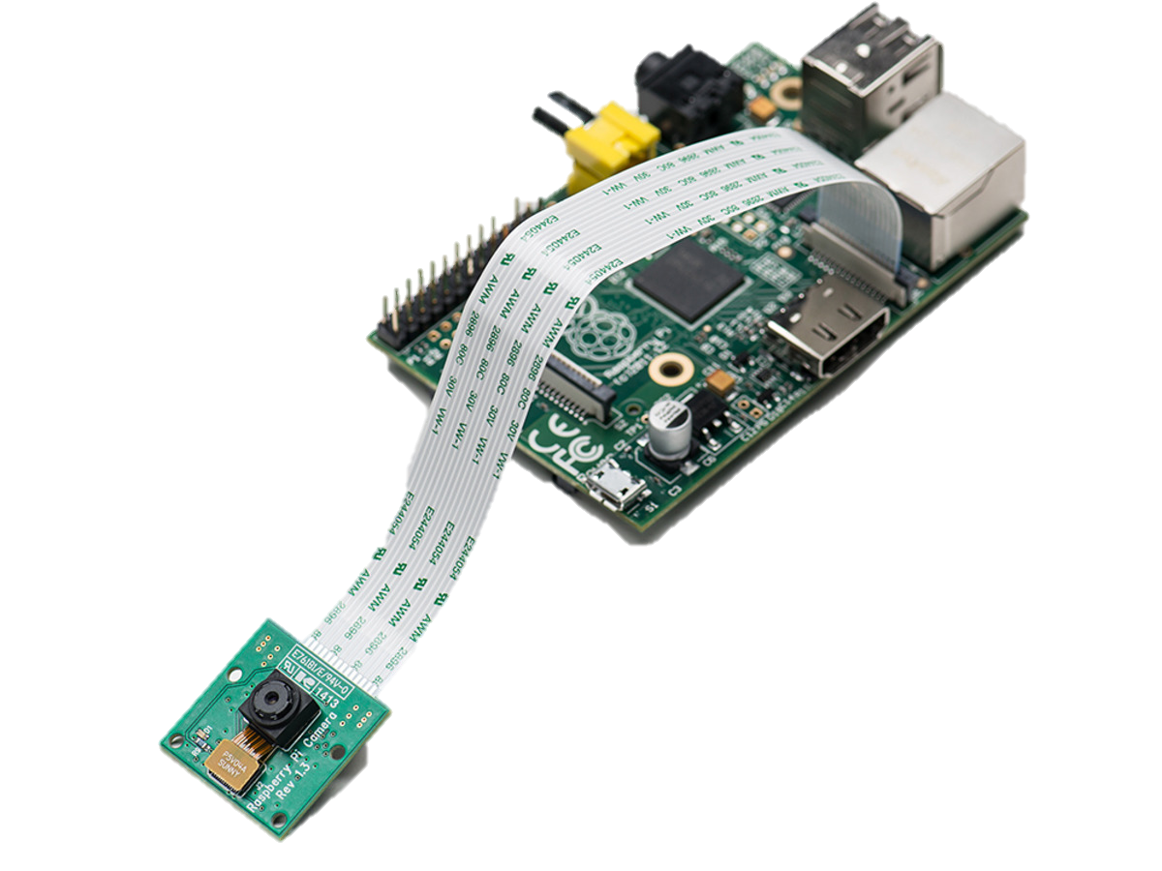
Using the Pi Camera
https://www.raspberrypi.org/learning/getting-started-with-picamera/worksheet/
Plug in Camera
Press Menu>Preference>Raspberry Pi Configuration>Interfaces
Make sure Camera is enabled

Slide 33
Using the Camera with Python
from picamera import PiCamera
from time import sleep
camera = PiCamera()
camera.rotation=0
camera.start_preview()
sleep(10)
camera.stop_preview()
camera.capture('/home/pi/Desktop/image.jpg')
camera.start_preview() camera.start_recording('/home/pi/video.h264') sleep(10) camera.stop_recording() camera.stop_preview()

Slide 34
Questions?

